Slide 1
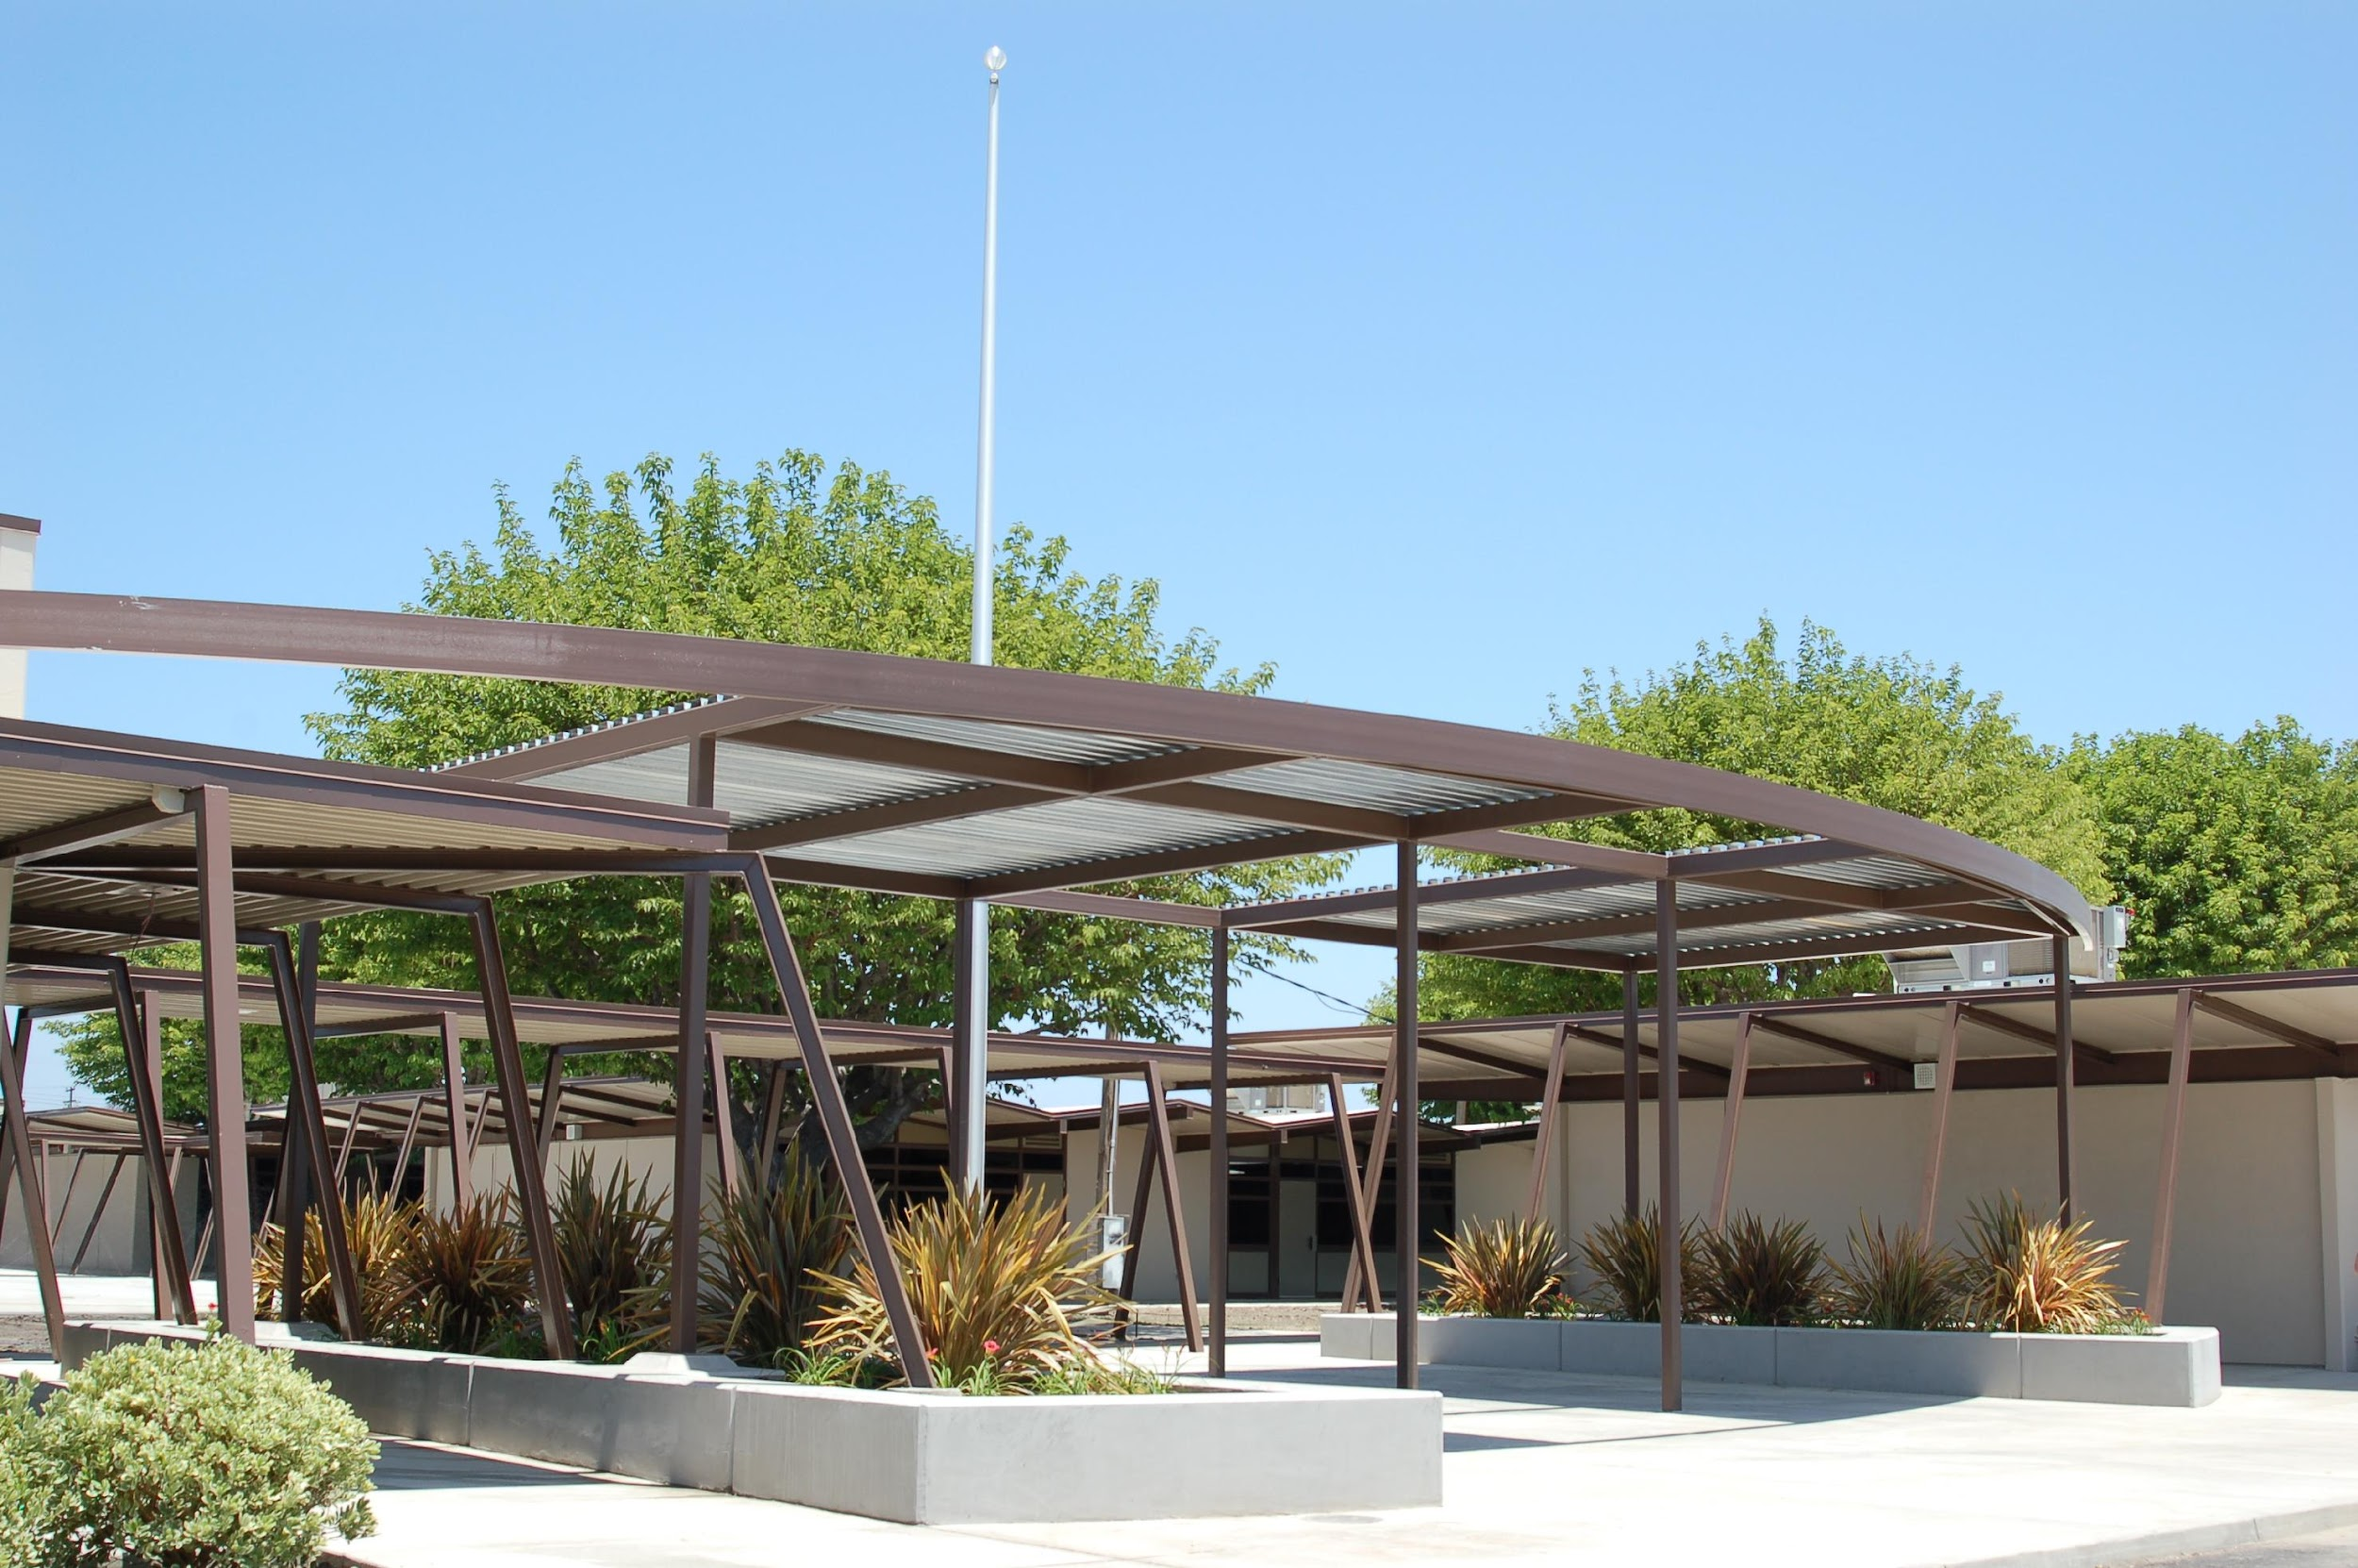
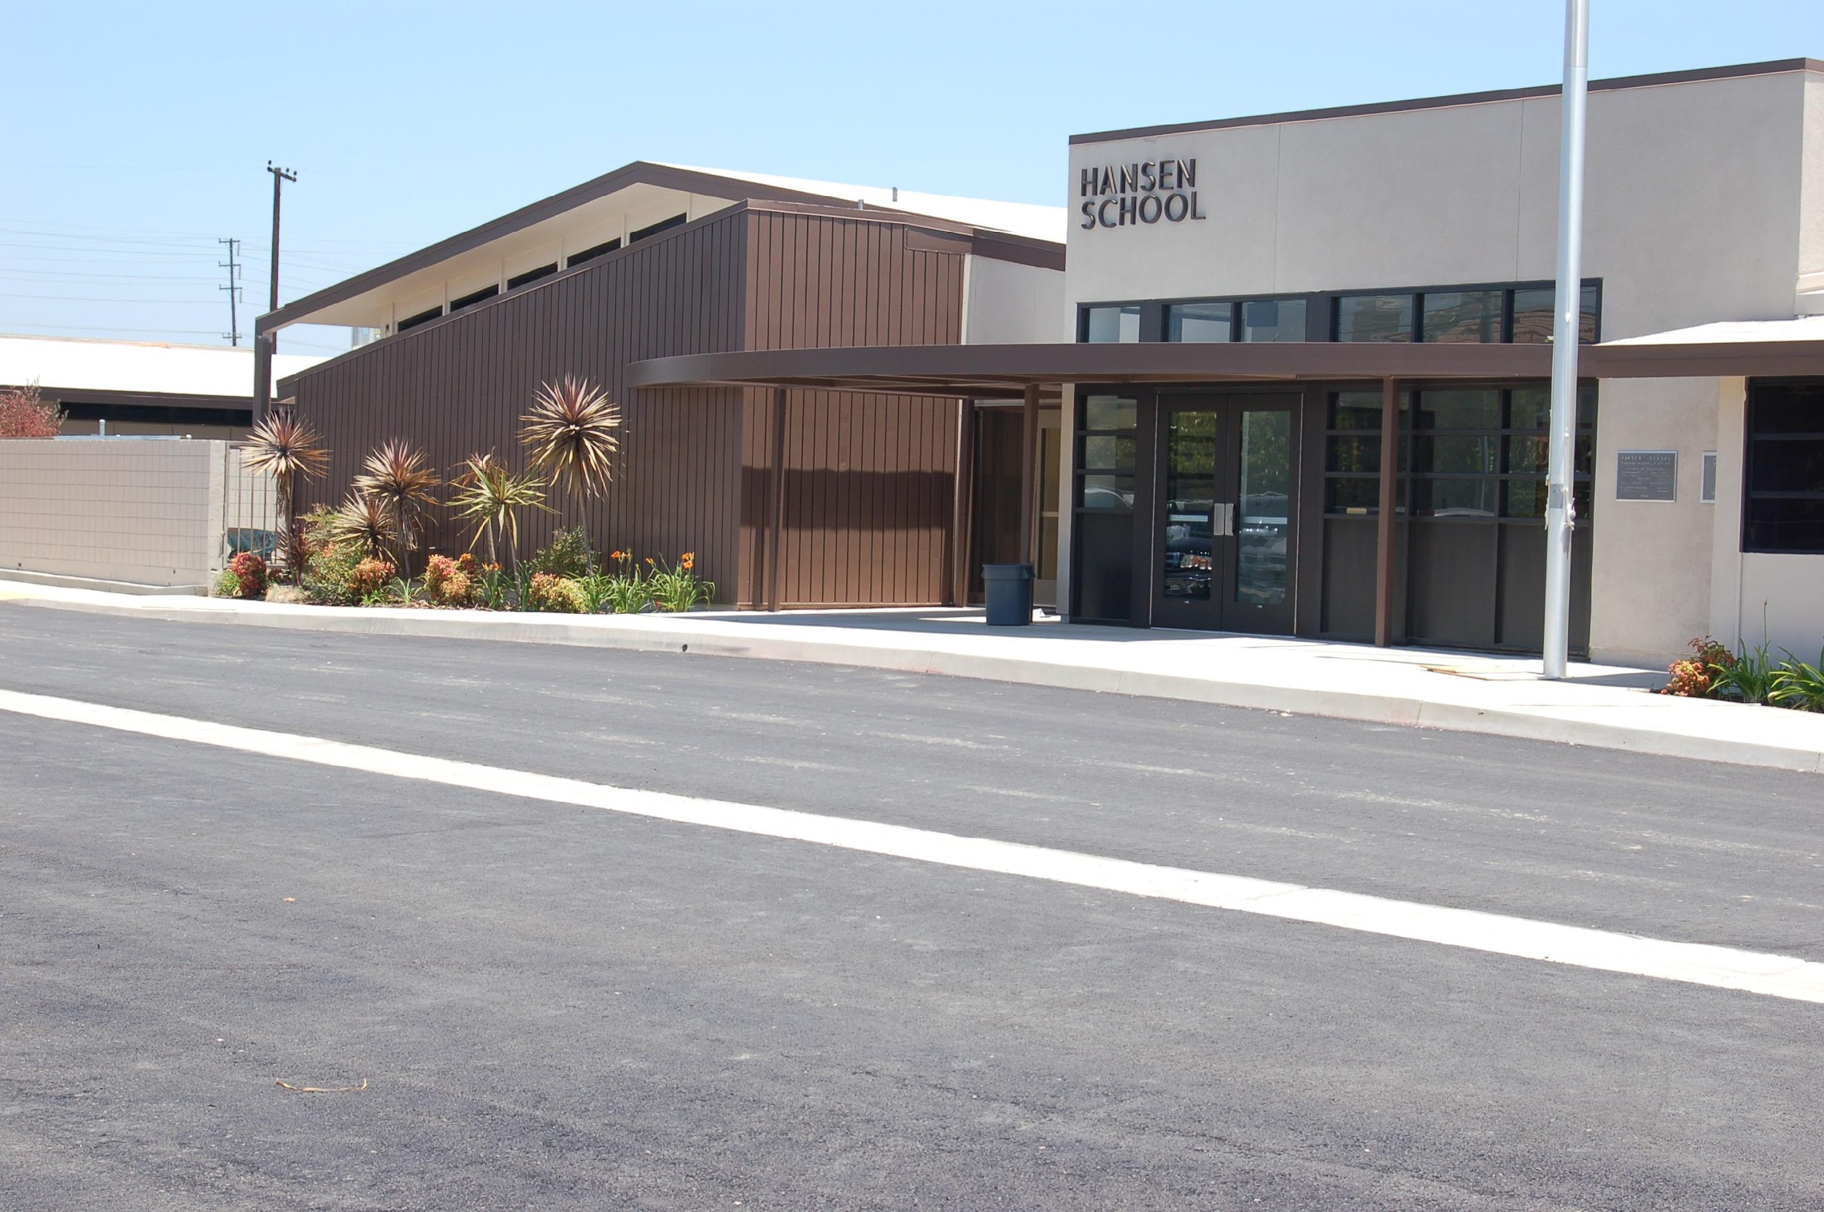
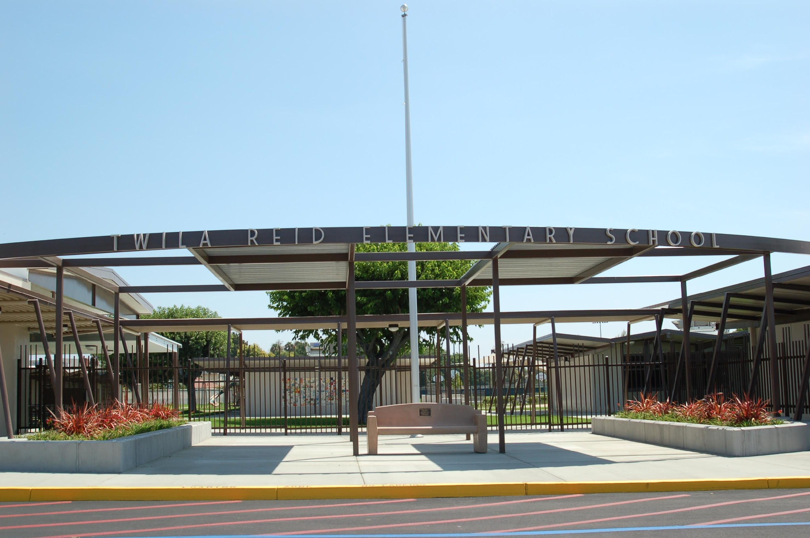
Plan for Reopening Schools
2023-24
Savanna School District
Updated: July 2023 Board Approved: July 11, 2023
This document is subject to change in accordance with state guidelines.

Slide 2
Table of Contents
Superintendent’s Message……………………………………………….…………………….….3
Health and Safety Protocols ……………………………………………………………….…….4
Quarantine and Isolation Calculator ……….…………………………………..………….….4
Protocols When Feeling Sick ….…………………………………………………………………5
Protocols for a Positive Test Result…………….………………….……………………….…...6
Other Safety Considerations……………………………………………..…….………………..7
Face Coverings and Personal Protective Equipment…………………………………..…….8
Health Screenings …………….…………………………………………..………..……..………9
School Facilities…………………………………………………………………..…………….…10
Classroom Heating, Ventilation, and Air Conditioning (HVAC) Units……..……...…..11
Food Services…………………………………………………………..….………….…………..12
Transportation…………………………………………………………..….……………………..13
Instructional Program for 2023-24…………………………………………….……………...14
Student and Staff Safety When on Campus …………………………………….…….…...15
Mental Health Support Services …………….…………………………………….…….…...15
Independent Study Program Option for 2023-24……………………………………..….16
Updated COVID-19 Prevention Program (June 2023)..…………..…………….….….17
This document is subject to change in accordance with state guidelines

Slide 3
Superintendent’s Message
We’re very excited that our schools will continue to follow a regular schedule of in-person learning during the 2023-24 school year! Please know that we continue to take every precaution to keep your children safe at school following health guidelines in place. Rest assured that we are committed to facilitating an optimal learning experience for our students and are here to support students, staff, parents, and our community during this time.
The state released the Updated California Department of Public Health guidance for K-12 schools on May 23, 2023. As a reminder, COVID-19 health requirements are set by state and county health officials, and school districts are required to follow the guidance in order to operate in-person instruction. This new guidance updates previous versions in two important ways including:
No person can be prevented from wearing a mask as a condition of participation in an activity or entry into a school, unless wearing a mask would pose a safety hazard (e.g., watersports).
CDPH recommends focusing on the other mitigation strategies provided in this guidance instead of implementing minimum physical distancing requirements for routine classroom instruction.
CDPH recommends that antigen tests be considered the primary option for detecting COVID-19 in schools, compared to PCR tests. It is important that we protect student privacy and will not divulge the name(s) of any person testing positive for COVID-19 to anyone other than themselves or his/her parents. It is not appropriate for anyone to attempt to learn such information or otherwise attempt to independently determine a student or staff member’s potential medical diagnosis. Please join me in ensuring a safe and supportive environment for our community and respect the privacy of others.
We know the best place for children to learn is at school with the amazing teachers we have. We’re pleased that the guidance continues to allow students, parents, and staff flexibility as we work together to do everything possible to keep our students, staff, and community safe.
As we begin the 2023-24 school year, we remain committed to the social and emotional health of our students, staff, and families. With the implementation of Second Step, our social-emotional curriculum, students are learning to develop a growth mindset, recognize emotions, develop empathy toward others and practice problem-solving skills. As we continue to focus on the well-being of our students, staff, and families in creating a healthy learning environment, we’ve partnered with Care Solace to provide an additional layer of care for our community. Care Solace helps individuals find mental health care providers and substance use treatment centers twenty-four hours a day, seven days a week. With Care Solace, families and staff gain access to a myriad of personalized support services quickly and confidentially with multilingual teams of providers. We are also excited about a potential partnership with Hazel Health that will provide our families with telehealth services upon referral from a member of our mental health team.
We continue to be deeply indebted to our school community for its ongoing support and are excited to welcome students, parents and staff back for in-person learning!
Dr. Sue Johnson
Superintendent of Savanna School District

Slide 4
Health and Safety Protocols
The safety of staff and students is Savanna School District's first priority. Savanna will continue to adhere to all necessary safety precautions. The steps outlined below will continue to be implemented on a routine basis to sanitize and disinfect:
Regular cleaning schedules are followed.
Signs are posted in workplaces and common areas, emphasizing basic infection- prevention measures, including hand-washing signs in restrooms.
Sanitizing stations are located throughout each school including at the school entrance, in the lunch area, on playgrounds, and in each classroom.
Soap and water at the sink are part of our standard in each classroom; these are kept supplied.
Staff and students are expected to wash/sanitize their hands regularly.
An informational video on the proper way to wash hands can be found on the district’s website here.
Schools and workplaces maintain adequate supplies to support healthy hygiene behaviors. Cleaning and disinfectant products align with the Environmental Protection Agency-approved list. Custodians will follow product instructions and Cal/OSHA requirements, including proper ventilation during cleaning and disinfecting.
The District continues to ensure that all HVAC systems operate consistent with CDPH guidelines. As per Cal/OSHA guidelines, the highest level of filtration efficiency compatible with the existing ventilation system are utilized.
Injury, Illness, and Prevention Plans for each district site are available on the district’s website here.
Click here for the 2023 State of California Safe Schools For All Hub.
Quarantine and Isolation Calculator
Want to know when you can safely leave home if you tested positive for COVID-19 or what to do when you find out a close contact has COVID-19?
Click here to access the new Quarantine and Isolation (Q&I) Calculator from the Centers for Disease Control and Prevention (CDC).
Please note the following:
The California Department of Public Health recently updated state quarantine guidance - click here for details.

Slide 5
Protocols When Feeling Sick
The quarantine requirements for students that are exposed to COVID -19 are part of our Reopening Schools Plan as well as the California Department of Public Health Guidelines. The intent with these guidelines is to ensure that all students have access to full in-person instruction and to as much instructional time as possible while keeping student and staff safety at the forefront of all we do.
Recommendations for staying home when sick and getting tested:
Follow the strategy for Staying Home when Sick and Getting Tested from the CDC.
Get tested for COVID-19 when symptoms are consistent with COVID-19.
If you show symptoms of COVID-19 infection , do not to return for in-person instruction until the following criteria have been met:
At least 24 hours have passed since resolution of fever without the use of fever-reducing medications; AND
Other symptoms are improving; AND
Have a negative test for SARS-CoV-2, OR a healthcare provider has provided documentation that the symptoms are typical of their underlying chronic condition (e.g., allergies or asthma) OR a healthcare provider has confirmed an alternative named diagnosis (e.g., Streptococcal pharyngitis, Coxsackie virus), OR at least 10 days have passed since symptom onset.
If the student or staff member tests positive for SARS-CoV-2, follow the guidance for isolation listed below:
Based on CDPH June 14, 2023 Guidelines, all persons with COVID-19 symptoms, regardless of vaccination status or previous infection, should:
Self-isolate and test as soon as possible to determine infection status. Knowing one is infected early during self-isolation enables (a) earlier access to treatment options, if indicated (especially for those that may be at risk for severe illness), and (b) notification of exposed persons (close contacts) who may also benefit by knowing if they are infected.
For symptomatic persons who have tested positive within the previous 90 days, using an antigen test is preferred.
Remain in isolation while waiting for testing results. If not tested, they should continue isolating for 10 days after the day of symptom onset, and if they cannot isolate, should wear a well-fitting mask for 10 days.
Consider continuing self-isolation and retesting with an antigen or PCR test in 1-2 days if testing negative with an antigen test, particularly if tested during the first 1-2 days of symptoms.
Continue to self-isolate if test result is positive and contact the healthcare provider about available treatments if symptoms are severe or the individual is at high risk for serious disease.
We know the best place for children to learn is at school with the amazing teachers we have.
Children may stay in school during the quarantine period so long as they continue to test negative. We encourage children who are tested because of an exposure to wear a mask, both indoors and outdoors, during the quarantine.

Slide 6
Protocols for a Positive Test Result
When a student has tested positive for COVID-19 (regardless of symptoms), we recommend they follow the CDC guidance by:
Staying home from school and other settings, including all extra-curricular activities, until receiving a negative COVID-19 test result.
It is important for a student in isolation to remain at home, separated from other people as much as possible, even if they do not have symptoms. They should not attend school or other extra-curricular or social activities while they are in isolation. They should not participate in activities like sporting events, play dates, parties, social and family gatherings, music or theater performances, and other events where they may come into contact with other people. To prevent other people from possibly getting COVID-19, make every effort to limit contact between the person in isolation and other people, including other household members, during the isolation period. Even if the person in isolation is wearing a mask, contact with other people should be limited.
If your child is young and needs regular assistance from an adult, designate one person in the household to be the primary caregiver during this time, and ensure the caregiver wears a mask as well.
Monitoring their symptoms. If they develop an emergency warning sign, seek emergency medical care immediately. Emergency warning signs include trouble breathing; persistent pain or pressure in the chest; new confusion; the inability to wake up or stay awake; and pale, gray, or blue-colored skin, lips, or nail beds (depending on skin tone).
Avoiding contact with other members of the household and pets by staying in a separate room and using a separate bathroom if possible.
Avoiding sharing personal household items, like cups, towels, and utensils.
Wearing a mask when around other people, including others within their household.
If the student requires a caregiver, please consult CDC’s advice on caring for someone sick to protect the caregiver and others.
The following are recommended guidelines and subject to change based on CDPH guidelines:
A person diagnosed with COVID-19 can be around others when
At least 10 days have passed since their symptoms began, or since the date of their initial positive test (use the date the test was collected) if they did not develop symptoms
and
If they had a fever, at least 24 hours have passed since the resolution of their fever without the use of fever-reducing medications
and
Other symptoms have improved.*
*Loss of taste and smell may persist for weeks or months after recovery and need not delay the end of isolation​.
OR
with improved symptoms and a negative COVID test done on Day 5 since symptoms began or when initially testing positive.
These recommendations do not apply to people with severe COVID-19 or with weakened immune systems (immunocompromised). Consult with a healthcare provider for their recommendations.
In addition, we encourage you to visit https://occovid19.ochealthinfo.com/ for additional information about COVID-19 in our community. CDC’s website also provides information about COVID-19, including an overview of isolation as it relates to the K-12 school setting at: https://www.cdc.gov/coronavirus/2019-ncov/community/schools-childcare/k-12-contact-tracing/about-isolation.html.

Slide 7
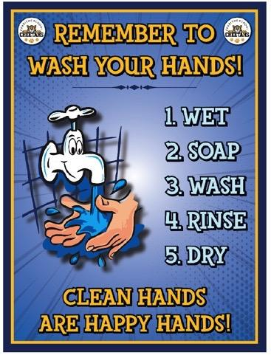
Other Safety Considerations
Schools continue to follow guidelines developed by the California Department of Public Health for cleaning and disinfecting school campuses.
Signage promotes healthy hygiene practices and reminders to stay home when ill.
Students are encouraged to bring refillable water bottles.
Water is available for students to use for handwashing as well as filling any water bottles they bring from home. In addition, each site has a water bottle filling station near the lunch area.
A full listing of all chemicals utilized on school campuses, along with Safety Data Sheets, is available on the district’s website here.

Slide 8
Face Coverings &
Personal Protective Equipment (PPE)
In accordance with the California Department of Public Health's (CDPH) Guidance for Face Coverings:
No student shall be prevented from wearing a mask as a condition of participation in an activity or entry into a school, unless wearing a mask would pose a safety hazard (e.g., watersports).
CDPH strongly recommends that all persons (e.g., students and staff) wear masks in K-12 indoor settings, with consideration of exemptions per CDPH face mask guidance.
Students and staff are frequently reminded not to touch the face mask and to wash
their hands frequently.
An informational video on the use of face masks is available on the district website here. The video provides information for all staff and families on proper use, removal, and washing of cloth face masks.
Face masks will be available in school offices for students who do not have a face mask and choose to use one.

Slide 9
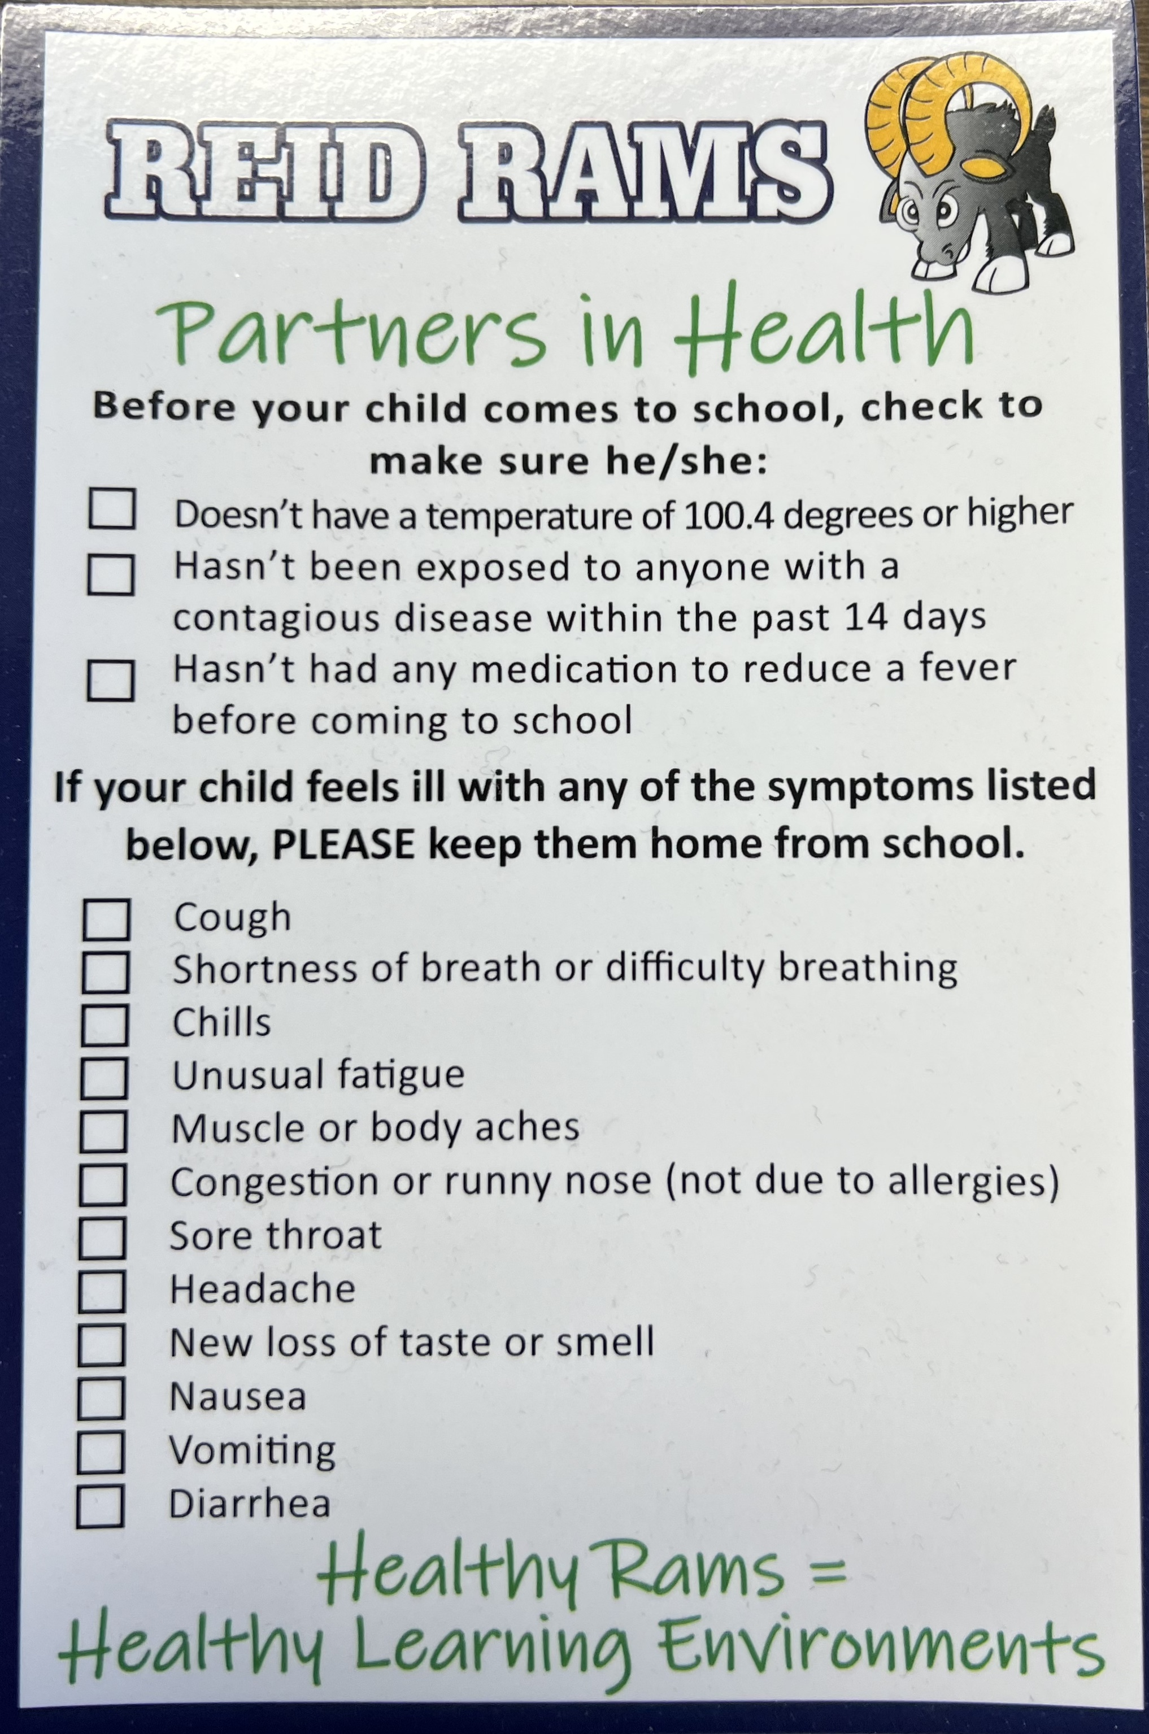
Health Screenings
Parents are asked to continue screening children at home until further notice to help ensure that individuals with COVID-19 symptoms do not come onto campus.
Parents are expected to keep children home from school when they have a fever of 100.4 degrees.
Parents shouldn’t send their child to school if they’ve been exposed to anyone with a contagious disease within the past 14 days.
Children shouldn’t be given fever reducing medication prior to coming to school; they should stay home if they have a fever.
Parents should screen children prior to sending them to school as follows:
Cough
Shortness of breath or difficulty breathing
Chills
Unusual fatigue
Muscle or body aches
Congestion or runny nose (not due to seasonal allergies)
Sore throat
Headache
New loss of taste or smell
Nausea
Vomiting
Diarrhea
An informational video on Staying Home When You’re Sick can be found on the district’s website here.

Slide 10
School Facilities
Thanks to the support of our school community and funding from School Bond Measures, the District has worked systematically to ensure that each school campus is as safe as possible. In an effort to continue to ensure the safety of all of our campuses, we have implemented a number of measures at all of our sites. Below are a few of the security measures in place:
Perimeter Fencing–Perimeter fencing with a 1” mesh has been installed throughout each campus.
Single Point of Entry–Access to each campus is limited to one access point; the entry gate is monitored each morning by an adult to ensure visitors are directed to check in through the office.
Security Cameras ‐ Security cameras have been installed throughout each campus; these cameras have proven to be extremely useful in helping deter crime.
Visitor Check in System–This system enhances school security by reading visitor drivers’ licenses, comparing the information to a national database, alerting campus administrators if a match is found; if no match was found, a visitor badge is printed that includes a photo. All visitors on a school site are to have a visitor badge.
Staff ID Badges–Staff members have been asked to wear their Savanna School District ID badge while on school campuses.
Paging Systems–Each site is equipped with a paging system that can be accessed from any site phone to make announcements or place the site into a ‘secure campus’ mode.
Paging Gates– We have installed paging phones at specific locations on each campus to allow access for parents with children enrolled in our after-school programs.
Student Transportation Services–Each bus is equipped with visual and audible cameras to assist drivers with student management as well as providing an additional layer of security for students and drivers. Students scan bus passes that provides real-time information on when and where students enter and exit the bus. We have tablets on each bus that allow the driver to verify students are exiting at the correct location.
Classroom Door Locks–Each classroom has exterior doors that can be locked from the inside, alleviating the need to open the door to lock it.
Enhanced Fire Alarm Systems–During the modernization projects at sites, the fire alarm systems were enhanced, updated and are fully automated and monitored.
Increased Security Lighting–After hours, each campus is lit with security lighting to ensure the continued safety and security of those working and to deter crime.
Monitored Security Systems–Each site has a monitored security system.
Partnership with Local Police Departments – Safety at each school has been enhanced through established relationships with our local police departments.
Because student and staff safety are paramount, we are continually assessing the safety and security needs of our campuses. We appreciate your continued diligence in alerting us or local law enforcement when you see something that doesn’t look right. If you have any questions about the safety and security of our campuses, please speak with your school principal. Together, we will be able to continue to ensure our schools are safe and secure learning environments.

Slide 11
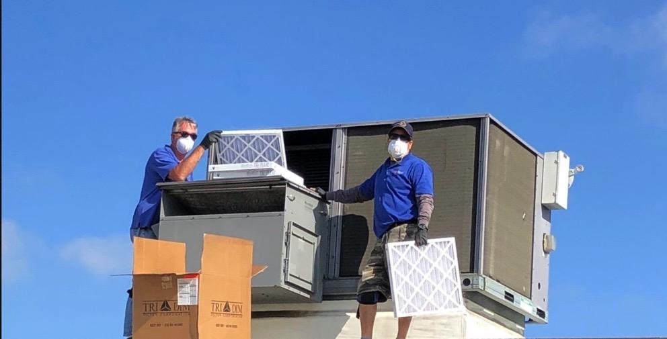
Classroom Heating, Ventilation &
Air Conditioning (HVAC) Units
Savanna School District is very fortunate to have a community that supported local bond measures that allowed for the installation of modern air conditioning and heating systems on each of the Savanna School District campuses. The modern systems allow for efficient means of supplying thermal comfort for our students. The units automatically optimize available fresh air and filter interior air while the units are in operation.
In order to ensure the health and safety of students and staff while on school campuses, the following guidelines continue to be followed:
The District shall ensure that all HVAC systems will operate consistent with CDPH guidelines. As per Cal/OSHA guidelines, the highest level of filtration efficiency compatible with the existing ventilation system shall be utilized.
Filters are changed quarterly or more often as needed.
HVAC units are inspected while the filters are being replaced to ensure they are in good repair.
Units are monitored continually using an online platform to ensure that units are functioning properly.
HVAC units installed in Savanna are considered ‘smart’ units and will automatically provide the proper air exchange based on interior and exterior conditions.
Air will be exchanged at the following rates based on conditions:
Low speed (500 cubic feet per minute) = 3.9 Air Changes per Hour
Medium speed (1000 cubic feet per minute) = 7.8 Air Changes per Hour
High speed (1500 cubic feet per minute) = 11.7 Air Changes per Hour
This allows for continual air scrubbing/cleaning while the units are in operation.
Fresh air will be introduced through the economizers as programmed by the equipment manufacturer. (15-20% at a minimum to as great as 35-50% as ambient temperature allows)

Slide 12
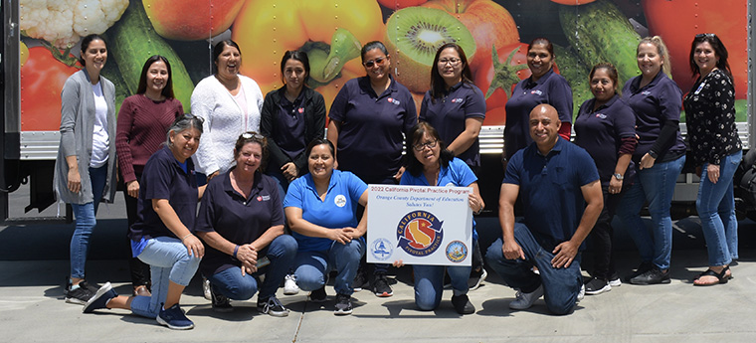
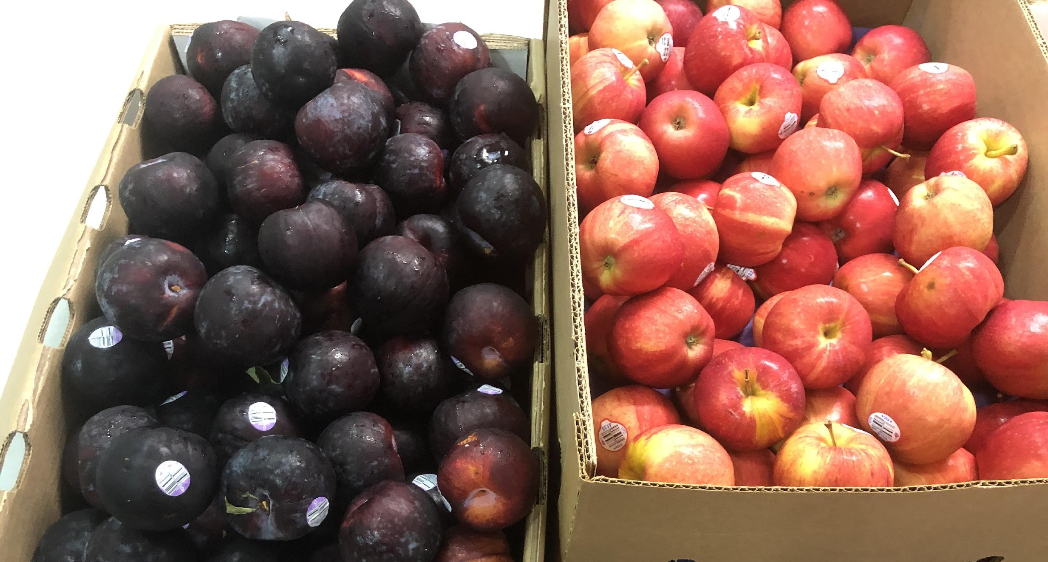
Food Services
We believe healthy eating and good nutrition go hand-in-hand. School meals offer proteins and grains, fruits and vegetables, and milk, which meet or exceed the requirements of the Healthy, Hungry-Free Kids Act.
Savanna School District will provide meals with student’s favorite breakfast and lunch entrées and a variety of fresh fruits and vegetables which meet all of the daily meal requirements.
School breakfast and lunch meals continue to be provided to all students free of charge during the 2023-24 school year. In addition, students attending any of our after school programs will be able to participate in the supper program.
Throughout the school year, our food services department will provide a selection of items for students to choose from. Breakfast meals consist of 1 serving of grain, ½ cup of fruit, and 8 oz of 1% lowfat milk or nonfat chocolate milk daily. A daily breakfast menu contains 400-500 calories per day and less than 10% of the total calories may contain saturated fat. Half of the grains offered must be whole grain-rich, sodium levels must be equal to or less than 540mg per day with zero trans fats.
Our lunch meals consist of 2 servings of grain & 2 servings of protein, ½ cup of fresh fruit and ½ cup of vegetable, and 8 oz of 1% lowfat milk or nonfat chocolate milk daily. A daily lunch menu contains 600-650 calories per day and less than 10% of the total calories may contain saturated fat. Half of the grains offered must be whole grain-rich, sodium levels must be equal to or less than 1,230 mg per day with zero trans fats.
Thanks to the receipt of Elementary and Secondary School Relief Fund (ESSER) monies, we have expanded the outdoor eating areas at each school site. This allows for additional distancing between students during meal times.

Slide 13
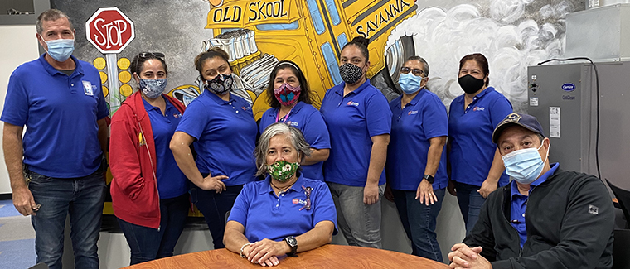
Transportation
The Savanna School District provides transportation for qualified students as follows:
Students who live more than a three-quarter mile walking distance from school.
Students who face hazardous walking conditions.
Students enrolled in a special education program not offered at the local school campus.
In order to ensure safety of students on our buses, students must scan his/her bus pass when entering and exiting the bus. In addition, if the bus is equipped with seat belts, all students are expected to remain seated and use seat belts on school buses at all times.
All of our school buses are equipped with video monitoring; this is one more enhancement to ensure student safety to and from school.
All kindergarten students must be met by a parent or a designated person (over the age of 18), in the Student Information Session in order to be released at his or her bus stop. This emergency card is located at the school site.
If the parent or designated person is not at the bus stop, the student will be returned to the next school on route.
After three "no shows" from a parent or designated person the student will be given a bus citation as a warning. If the parent or designated person continues to not be present at the bus stop a second citation will be issued with the student possibly receiving time off the bus.

Slide 14
Instructional Program for 2023-24
Students will participate in in-class learning Monday through Friday on a full day schedule. Homework assignments will be provided in accordance with Board Policy outside of class time.
Parents are expected to keep children home from school when they have a fever, cough, or are feeling ill.
Sanitizing stations are located throughout each school including at the school entrance, in the lunch area, on playgrounds, and in each classroom. Soap and water at the sink are part of our standard in each classroom; these are kept supplied. Drinking fountains are available in classrooms and on campus. Water is available for students to use for handwashing as well as filling any water bottles they bring from home. In addition, each site has a water bottle filling station near the lunch area.
All guidelines outlined by the California Department of Public Health related to cleaning and sanitizing school facilities will be followed.
Mandates by the Orange County Health Care Agency, California Department of Public Health, and the Centers for Disease Control will be followed.
We will closely monitor changes in guidelines and keep parents informed of any changes.

Slide 15
Student & Staff Safety When on Campus
To ensure the health and safety of students and staff, a number of safety provisions will continue for the 2023-24 school year. These include:
School Supplies: Students are welcome to bring personal backpacks and supplies from home; however, supplies are provided by the school as well.
Electronic Devices: Chrome Books will be available for check-out for our students in grades 3-6. Students will be expected to adhere to the District’s Technology Use Guidelines at all times.
Regular Hand Cleaning: Students are encouraged to participate in hand washing and/or hand sanitizing regularly throughout the school day.
Drinking Water: Students are encouraged to bring a water bottle from home that can be refilled in the classroom or at the water bottle filling station on campus. Parents should label the water bottle with the student’s name and grade.
Recess Time: Students are encouraged to use playgrounds during regularly scheduled recess times.
Cleaning: Classrooms and restrooms continue to be cleaned on a regular schedule
School Meals: School meals continue to be provided to all students free of charge.
Vaccines: One of the most important tools we have to help keep each other safe is getting vaccinated.
All mandates of the California Department of Public Health continue to be followed.
Mental Health Support Services
As important as the physical safety and security of our campuses is, the social-emotional security our students need is critically important. With the implementation of Second Step, our social-emotional curriculum, students are learning to develop a growth mindset, recognize emotions, develop empathy toward others and practice problem-solving skills. The success of the digital online version of the Second Step curriculum last year provided a strong foundation for us to continue to address the social-emotional development, safety, and well-being of students. As we continue to focus on the well-being of our students, staff, and families in creating a healthy learning environment, we’ve partnered with Care Solace to provide an additional layer of care for our community. Care Solace helps individuals find mental health care providers and substance use treatment centers twenty-four hours a day, seven days a week. With Care Solace, families and staff gain access to a myriad of personalized support services quickly and confidentially with multilingual teams of providers. Information on how families can access services from Care Solace can be found on the District’s website.

Slide 16
Independent Study Option for the 2023-24 School Year
The Savanna School District and Orange County Department of Education will partner to provide an Independent Study option for parents who are interested in an alternative education program for the 2023 - 2024 school year.
The Community Home Education Program (CHEP) is an Orange County Department of Education, Independent Study/Home School option for families of TK-6th grade students. Parents are assigned to a credentialed teacher that provides support and academic expectations and guidance.
CHEP supports parents who wish to take a prominent role in the daily academic delivery for their children. Families receive both teacher editions and student editions of all state adopted grade level curriculum from CHEP; note that the materials may be different from Savanna's adopted curriculum.
Minimum monthly parent, student, teacher conferences are required. Grade level support courses, electives and lessons will be provided as follows: TK-3rd grade synchronous daily lessons; 4th-6th grades daily check in and a weekly synchronous lessons. All required state assessments and school assigned assessments are a required part of the program. Social and academic support staff are available.
Note: “Synchronous instruction” means classroom-style instruction or designated small group or one-on-one instruction delivered in person, or in the form of internet or telephonic communications, and involving live two-way communication between the teacher and pupil. Synchronous instruction shall be provided by the teacher of record.
If you do not follow the Independent Study Agreement, you will be reassigned to the Savanna School District. If a place within your school of residence is not available at your child's grade level, he/she will be assigned to a classroom within the district.
In order to enroll in the Independent Study program the following steps will need to be completed:
1. Complete this Jot Form. https://form.jotform.com/SavannaSD/2023-2024-tk-6th-independent-study
2. A district administrator will contact you for a meeting to discuss program details.
3. You will be given information for registration through the Orange County Department of Education Independent Study Program.

Slide 17
COVID-19 Prevention Program Cal/OSHA
This COVID-19 Prevention Program (CPP) is considered an addendum to the District’s Injury & Illness Prevention Program, copies of which are available on the District’s website at https://www.savsd.k12.ca.us/info/school-district/maintenance--operation---and--transportation This is based on the June 23, 2023, Non-Emergency COVID-19 Prevention Regulations that remain in effect until February 3, 2025. The foundational principle of this guidance is that all students must have access to safe and full in-person instruction and to as much instructional time as possible.
Please note that the requirements outlined here are subject to change based on revisions by CDPH and/or Cal/OSHA; we will continue to follow all state and local health guidelines.
This COVID-19 Prevention Program is designed to control exposures to the SARS-CoV-2 virus that may occur in our workplace. The protocols outlined in this CPP are intended to supplement existing District policies and procedures, applicable agreements, and relevant requirements imposed by state and local health agencies.
I. AUTHORITY AND RESPONSIBILITY
The Superintendent or designee has overall authority and responsibility for implementing the provisions of this CPP. In addition, all supervisors are responsible for implementing and maintaining the CPP in their assigned work areas and responding to questions by employees about the CPP.
All employees are responsible for using safe work practices, following all directives, policies and procedures, applicable collective bargaining agreements and memoranda of understanding with exclusive bargaining representatives, and assisting in maintaining a safe work environment.
The District shall conduct periodic inspections as needed to identify unhealthy conditions, work practices, and work procedures related to COVID-19 and to ensure compliance with employers' COVID-19 policies and procedures.
II. IDENTIFICATION AND EVALUATION OF COVID-19 HAZARDS
Workplace Hazards
The following will be implemented in the workplace as needed to address potential COVID-19 hazards in accordance with applicable agreements:
Assessment of workplace-specific exposure to persons at, or who may enter, the District sites.
Evaluation of existing COVID-19 prevention controls and the need for different or additional controls.
Implementation of periodic inspections as needed to identify unhealthy conditions, work practices, and work procedures related to COVID-19 and to ensure compliance with current COVID-19 orders and directives from the California Department of Health, Cal/OSHA, and local health departments.

Slide 18
COVID-19 Prevention Program Cal/OSHA (continued)
Employees and their authorized representatives are encouraged to bring to the District’s attention any potential health or safety hazard that may exist in the work area and assist in the evaluation of such hazards as appropriate. The attached Employee Safety Recommendation form (or equivalent) can be used for this purpose. These forms are available in the District Office and at each school site. Supervisors will follow up all suggestions and investigate the concerns brought up through these communication methods.
Feedback to the employees is critical, and must be provided for effective two-way communication. The District will pursue readily understandable health and safety communications for all affected employees.
Employee Self-Screening
All students, employees, and visitors should perform daily health checks to ensure no COVID-19 symptoms exist prior to entering school. Staff and students with any symptom consistent with COVID-19 or who have had close contact with a person with COVID-19 should be sent home or sent to an isolation area on site pending travel home.
III. CONTROL OF COVID-19 HAZARDS
The District will implement reasonable guidelines to mitigate employee exposure to the coronavirus in the workplace as follows:
Engineering Controls
Ventilation should be optimized as per CDPH Guidelines. Public health officials indicate that proper ventilation is necessary to minimize the transmission and infection from COVID-19 especially for individuals in a closed space for extended periods of time by reducing the airborne concentration of the virus and thus the risk of transmission and infection of COVID-19 through the air.
The District shall ensure that all HVAC systems will operate consistent with CDPH guidelines. As per Cal/OSHA guidelines, the highest level of filtration efficiency compatible with the existing ventilation system shall be utilized. The District shall ensure air filters are changed quarterly.
Cleaning and Disinfecting
The District shall ensure that all classrooms, restrooms, and workspaces are cleaned and disinfected regularly. Disinfecting includes providing disinfecting products that are EPA approved for use against the virus that causes COVID-19 and follows the manufacturer’s instructions for all cleaning and disinfection products (for example, safety requirements, PPE, concentration, and contact time). If a facility has had a sick person with COVID-19 within the last 24 hours, clean and disinfect the spaces occupied by that person during that time.
Hand Sanitizing
Teach and reinforce washing hands, avoiding contact with one's eyes, nose, and mouth, and covering coughs and sneezes among students and staff.
Promote hand washing throughout the day, especially before and after eating, after using the toilet, and after handling garbage, or removing gloves.
Ensure adequate supplies to support healthy hygiene behaviors, including soap, tissues, no-touch trash cans, face coverings, and hand sanitizer.

Slide 19
COVID-19 Prevention Program Cal/OSHA (continued)
IV. INVESTIGATING AND RESPONDING TO COVID-19 CASES
Investigation Procedures
The District will implement effective procedures to investigate COVID-19 cases in the workplace, including seeking information from employees regarding COVID-19 cases and close contacts, COVID-19 test results, and onset of COVID-19 symptoms, and identifying and recording COVID-19 cases.
Where there has been a COVID-19 case at a District worksite, and in the event there is a COVID-19 outbreak and/or a major outbreak, the District will take the following actions:
Determine the day and time the COVID-19 case was last present and, to the extent possible, the date of the positive COVID-19 test(s) and/or diagnosis, and the date the COVID-19 case first had one or more COVID-19 symptoms, if any were experienced.
Determine who may have had a close contact.
Give notice of the potential COVID-19 exposure, within one business day, in a way that does not reveal any personal identifying information of the COVID-19 case, to all employees who may have had COVID-19 exposure and their authorized representatives, and independent contractors and other employers present at the workplace during the high-risk exposure period.
Make COVID-19 testing available at no cost, during paid time to all employees who had a close contact in the workplace and provide them with the information on benefits with the following exceptions:
Case reporting, contact tracing, investigation and quarantine
Per AB 86 (2021) and California Code Title 17, section 2500, schools are required to report COVID-19 cases to the local public health department.
COVID-19 cases, regardless of vaccination status or previous infection, who do not develop COVID-19 symptoms or whose COVID-19 symptoms are resolving, shall not return to work until:
At least five days have passed from the date that COVID-19 symptoms began or, if the person does not develop COVID-19 symptoms, from the date of first positive COVID-19 test;
At least 24 hours have passed since a fever of 100.4 degrees Fahrenheit or higher has resolved without the use of fever reducing medications; and
A negative COVID-19 test from a specimen collected on the fifth day or later is obtained; or, if unable to test or the employer chooses not to require a test, 10 days have passed from the date that COVID-19 symptoms began or, if the person does not develop COVID-19 symptoms, from the date of first positive COVID-19 test.

Slide 20
COVID-19 Prevention Program Cal/OSHA (continued)
COVID-19 cases, regardless of vaccination status or previous infection, whose COVID-19 symptoms are not resolving, may not return to work until:
At least 24 hours have passed since a fever of 100.4 degrees Fahrenheit or higher has resolved without the use of fever-reducing medication; and
Symptoms are resolving or 10 days have passed from when the symptoms began.
Regardless of vaccination status, previous infection, or lack of COVID-19 symptoms, a COVID-19 case shall wear a face covering in the workplace until 10 days have passed since the date that COVID-19 symptoms began or, if the person did not have COVID-19 symptoms, from the date of their first positive COVID-19 test.
These requirements apply regardless of whether an employee has previously been excluded or other precautions were taken in response to an employee's close contact or membership in an exposed group.
If an order to isolate, quarantine, or exclude an employee is issued by a local or state health official, the employee shall not return to work until the period of isolation or quarantine is completed or the order is lifted. If no period was specified, then the period shall be in accordance with the return to work periods identified above.
If no violations of local or state health officer orders for isolation, quarantine, or exclusion would result, the District may, upon request, allow employees to return to work on the basis that the removal of an employee would create undue risk to a community's health and safety. In such cases, the District shall develop, implement, and maintain effective control measures to prevent transmission in the workplace including providing isolation for the employee at the workplace and, if isolation is not feasible, the use of respirators in the workplace.
Confidentiality of Investigation
All personal identifying information of COVID-19 cases or symptoms will be kept confidential. All COVID-19 testing or related medical services provided by the District will be provided in a manner that ensures the confidentiality of employees, with the exception of unredacted information on COVID-19 cases that will be provided immediately upon request to the local health department, CDPH, Cal/OSHA, the National Institute for Occupational Safety and Health (NIOSH), or as otherwise required by law.
All employees’ medical records will also be kept confidential and not disclosed or reported without the employee’s express written consent to any person within or outside the workplace, with the following exceptions: (1) Unredacted medical records provided to the local health department, CDPH, Cal/OSHA, NIOSH, or as otherwise required by law immediately upon request; and (2) Records that do not contain individually identifiable medical information or from which individually identifiable medical information has been removed.

Slide 21
COVID-19 Prevention Program Cal/OSHA (continued)
System for Communicating
The District will implement a communication system with employees on matters relating to COVID-19 mitigation and response to ensure employees’ safety in the workplace. This will include a clear and concise exchange of information between the District and employees by providing a single point of contact for supervisors.
District employees will be encouraged to freely communicate with their supervisors concerning COVID-19 symptoms, possible COVID-19 exposures, possible COVID-19 workplace concerns and hazards, and suggestions for correction of potential hazards without fear of reprisal.
District employees will be asked to report to their immediate supervisor concerns regarding COVID-19 mitigation practices or possible COVID-19 exposure in the workplace without fear of reprisal.
Supervisors who, after assessing the concern, determine that additional guidance or assistance is required shall contact the Executive Assistant to the Superintendent who will triage the report and notify essential personnel for an appropriate response.
Employees with a disability, medical or other condition that places them at increased risk of severe COVID-19 illness and an accommodation is needed, will be encouraged to report it to their supervisor without fear of reprisal. The District will engage in the interactive process by evaluating the request and determining, with input from the employee and their health care provider, whether the employee can be accommodated and what reasonable accommodations will be offered.
Training and Instruction
The District will offer training and instruction that includes:
Providing information on policies and procedures on COVID-19 hazards impacting employees.
Providing information concerning the contagious nature of COVID-19 including:
COVID-19 is an infectious disease that can be spread through the air.
COVID-19 may be transmitted when a person touches a contaminated object and then touches their eyes, nose, or mouth.
An infectious person may have no symptoms.
Employees will have access to any benefits available under legally mandated sick and vaccination leave, and, if applicable, workers’ compensation law.
Employees who are not fully vaccinated may request a respirator for voluntary use; employees requesting use of a respirator will be provided with training on its use.
Implement any other control measures as required by Cal/OSHA.

Slide 22
COVID-19 Prevention Program Cal/OSHA (continued)
Food service recommendations
1. Arrange for eating outdoors as much as feasible.
Clean frequently touched surfaces. Surfaces that come in contact with food should be washed, rinsed, and sanitized before and after meals.
Given very low risk of transmission from surfaces and shared objects, there is no need to limit food service approaches to single use items and packaged meals.
Vaccination
COVID-19 vaccination is strongly recommended for all eligible people in California, including teachers, staff, students, and adults sharing homes with these members of our school communities. Vaccination is effective at preventing COVID-19, protecting against both transmission and serious illness or death.
COVID-19 SAFETY PLANNING TRANSPARENCY RECOMMENDATIONS
In order to build trust in the school community and support successful return to school, it is a best practice to provide transparency to the school community regarding the school’s safety plans. Savanna School District shall post a safety plan, communicating the safety measures in place for 2023-24, on the District website. It will be reviewed at least every six months for possible revisions.

Slide 23
COVID-19 Prevention Program Cal/OSHA
EMPLOYEE HAZARD IDENTIFICATION AND SAFETY RECOMMENDATION FORM
SAVANNA SCHOOL DISTRICT EMPLOYEE HAZARD IDENTIFICATION AND SAFETY RECOMMENDATION FORM
LOCATION: | DEPT:
SUPERVISOR: | DATE:
IDENTIFICATION OF SAFETY OR HEALTH HAZARD
SUGGESTION FOR ABATEMENT OF THE SAFETY OR HEALTH HAZARD
DO NOT WRITE BELOW THIS LINE
Date complaint was investigated:
Investigated by:
Action taken:
Date Action was reported to the employee:
Comments:

